Slide 1
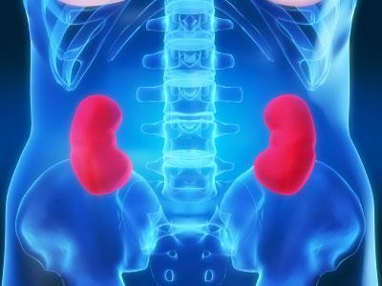
Kidney function, disease & health
http://health.howstuffworks.com/human-body/systems/kidney-urinary/kidney.htm

Slide 2
Why are our kidneys important?
Regulate the composition of your blood
Keep the concentrations of various ions and other important substances constant.
Keep the volume of water in your body constant.
Remove wastes from your body.
Keep the pH of your blood constant
Help regulate your blood pressure.
Stimulate the making of red blood cells.
Maintain your body's calcium levels.

Slide 3
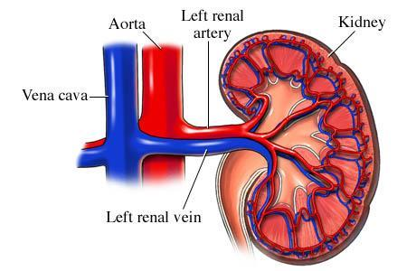
How is the kidney structured?

Slide 4
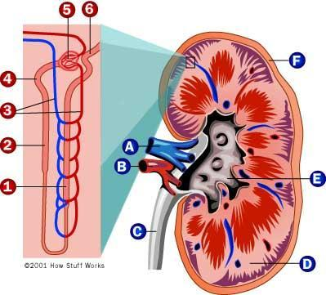
How do our kidneys work?
Filtration
Reabsorption
Secretion

Slide 5
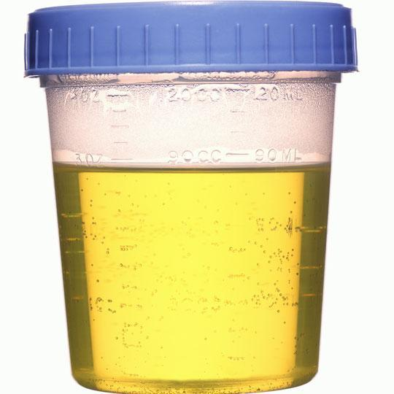
How do our kidneys filter?
Filtration: Blood is forced through small tubes. Excess Ions are diffused out of the cells
Excess Water moves via osmosis from the cells.
The resulting filtrate is our urine.
Notes:
In the proximal convoluted tubule,reabsorption glucose and amino acids takes place through active transport(perform by abundance of mitochondria in the cells of proximal convoluted tubule),therefore no glucoce is found in the urine.

Slide 6
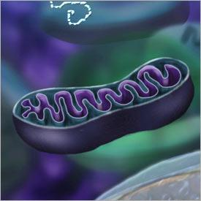
How does re-absorption work?
Certain molecules such as Glucose, Ions and Amino Acids are reabsorbed from the filtrate through specialized cells in the kidney system.
These cells have an abundance of mitochondria.

Slide 7
Making Connections
What is the purpose of mitochondria?
- Mitochondria are the “power house” of our cells. They convert the food we eat into a form of stored energy called ATP.
Why would the specialized re-absorption cells in our body have an abundance of mitochondria?
- This is our bodies last attempt at getting the most out of the food we eat. The more mitochondria in these specialized cells, the more our body can absorb at the last minute and convert into stored energy that our body can used to carry out its functions.

Slide 8
What happens when our kidneys fail?
High blood pressure occurs as a result of high salt concentrations.
Toxins build up in our blood stream.
The pH of our blood is no longer in balance.
Our body can no longer maintain Homeostasis.
Anemia occurs.
Notes:
Diabetic Kidney Disease
Diabetes is a disease that keeps the body from using glucose, a form of sugar, as it should. If glucose stays in the blood instead of breaking down, it can act like a poison. Damage to the nephrons from unused glucose in the blood is called diabetic kidney disease. Keeping blood glucose levels down can delay or prevent diabetic kidney disease. Use of medications called angiotensin-converting enzyme (ACE) inhibitors or angiotensin receptor blockers (ARBs) to treat high blood pressure can also slow or delay the progression of diabetic kidney disease.
High Blood Pressure
High blood pressure can damage the small blood vessels in the kidneys. The damaged vessels cannot filter wastes from the blood as they are supposed to.
A doctor may prescribe blood pressure medication. ACE inhibitors and ARBs have been found to protect the kidneys even more than other medicines that lower blood pressure to similar levels. The National Heart, Lung, and Blood Institute (NHLBI), one of the National Institutes of Health, recommends that people with diabetes or reduced kidney function keep their blood pressure below 130/80.
Glomerular Diseases

Slide 9
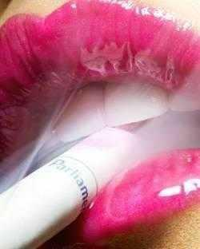
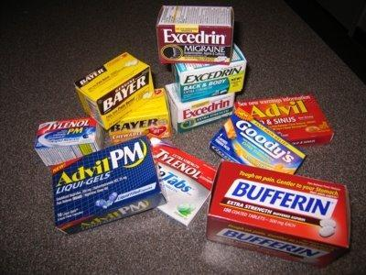
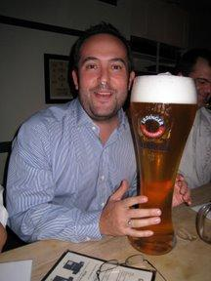
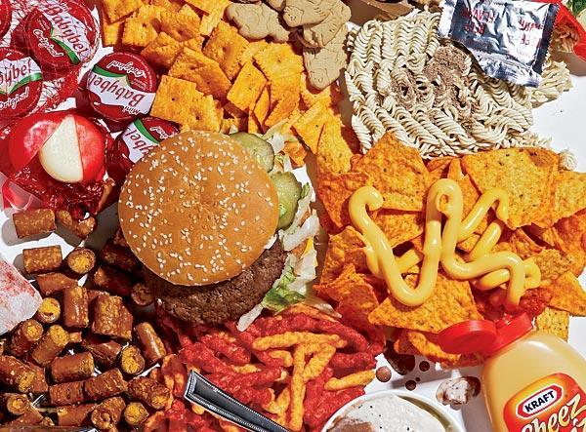
Why do our kidney’s fail?
Diabetes, due to high concentrations of glucose.
High blood pressure
Genetics
Poisons/Toxins

Slide 10
What are signs of CKD?
Frequent Urination
Lack of Urination
Fatigue
Loss of appetite and/or nausea
Swelling in hands or feet
Discoloration of the skin
Muscle cramps

Slide 11
How can you keep your kidney’s healthy?
Monitor your blood pressure.
Eat a healthy, well balanced diet.
Exercise regularly.
Avoid toxins such as alcohol, tobacco, excessive caffeine.

Slide 12
Organ Donation
You can become an organ donor when you receive your drivers license.
How do we decide who gets organs?
http://www.organtransplants.org/faces/story.php?id=2

Slide 13
Living with Chronic Kidney Disease
http://www.youtube.com/watch?v=WZosHub0MOQ&feature=related

