Slide 1
Urogenital System
The urogenital system is comprised of the organs that make up the urinary system
2 kidneys
2 ureters
1 bladder
1 urethra
It also includes the reproductive system. These organs are different for males and females, although many are homologous structures. We will explore this system in more detail later.

Slide 2
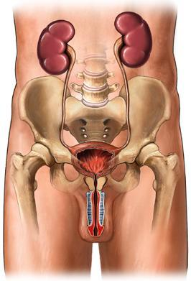
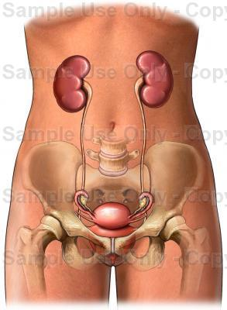

Slide 3
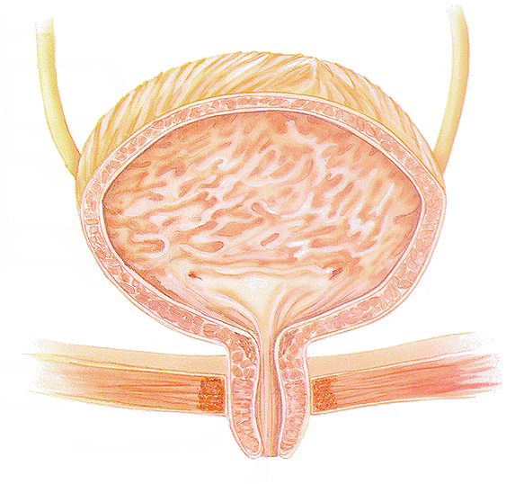
Urinary Bladder
ureters
internal sphincters
external sphincters
urethra

Slide 4
Sphincter Muscles on Bladder
Internal urethral sphincter:
Smooth muscle
Involuntary control
External Urethral sphincter:
Skeletal muscle
Voluntary control

Slide 5
Urine is comprised of…
Water- 95%
Nitrogenous waste:
Ions:
sodium
potassium
sulfate
phosphate

Slide 6
Nitrogenous Waste…
Urea
produced when the liver breaks down protein or amino acids; the kidneys then transfer the urea from the blood to the urine.
Uric acid
- waste product from cells dying and foods.
Creatinine
- By-product from muscle use

Slide 7
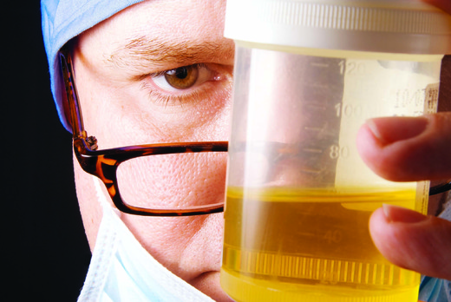
Urinalysis
Why do doctors ask for a urine sample?
characteristics:
smell- ammonia-like
pH- 5.5-8.0
*specific gravity– more than 1.0; ~1.001-1.003
color- affected by what we eat: salty foods, vitamins
*

Slide 8
Odor
A normal urine odor is odorless or ammonia-like
diabetes- smells fruity or acetone like due to elevated ketone levels, a chemical created when the body breaks down fats for energy.
smells yucky, like the smell of urine after eating asparagus.

Slide 9
pH – Potential Hydrogen.
Average pH range is 5.5 - 8.0.
Vegetarian diet- urine is alkaline
Protein rich and wheat diet- urine is acidic
Cranberry juice can also cause higher acidity in urine.
Ailments - Starvation, dehydration, respiratory diseases, and uncontrolled diabetes can all cause urine pH to become highly acidic.

Slide 10
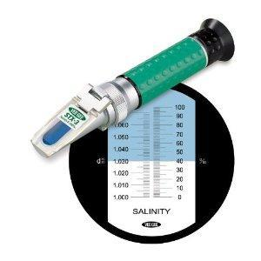
Specific Gravity
Specific gravity measures the solute concentration in a urine sample.
Water: s.g. = 1g/L;
Urine: s.g. ~ 1.002 to 1.003 g/L
Abnormally low or high specific gravity, suggests a problem with the urinary system, such as diabetes.

Slide 11
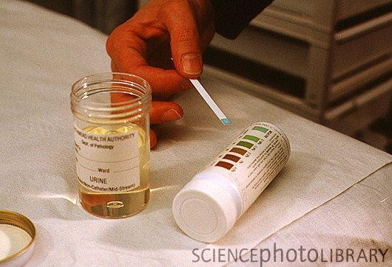
Abnormal Constitutes of Urine
Glucose- Glucose is not typically found in urine.
Presence of glucose, is indicative of:
Excessive carbohydrate intake
Stress
Diabetes

Slide 12
Abnormal Constitutes of Urine
Ketone bodies- normal in urine but in small amts
Excess Ketones - found during starvation, using fat stores
If excess ketone levels is coupled w/a finding of glucose-- which is usually diagnosed as diabetes.
Bile pigments-
Greenish coloration – Suggests disease of the liver such as hepatitis or cirrhosis

Slide 13
Urinary Tract Infections
Urinary Tract Infections (UTI’s) are a common ailment.
Women are more likely to get a urinary tract infection than men.
Why?
Women are likely to experience at least one UTI in their lifetime.
Symptoms of a UTI include:
Painful Urination (burning)
Urgency to urinate with little output
High frequency of urination
Blood in urine
Fever
Prevention:
Wipe front to back
Urinate right after sexual intercourse
Take estrogen supplements
If you gotta go, GO!
Avoid spermicides
Avoid stress and excess carb intake.

Slide 14
How common are UTI’s?
VERY
UTI's are one of the most common bacterial infections.
7,000,000 doctor's office visits and about 100,000 hospitalizations in the United States.
The estimated annual cost of UTIs in this country? A cool $1.6 billion.

